Slide 1
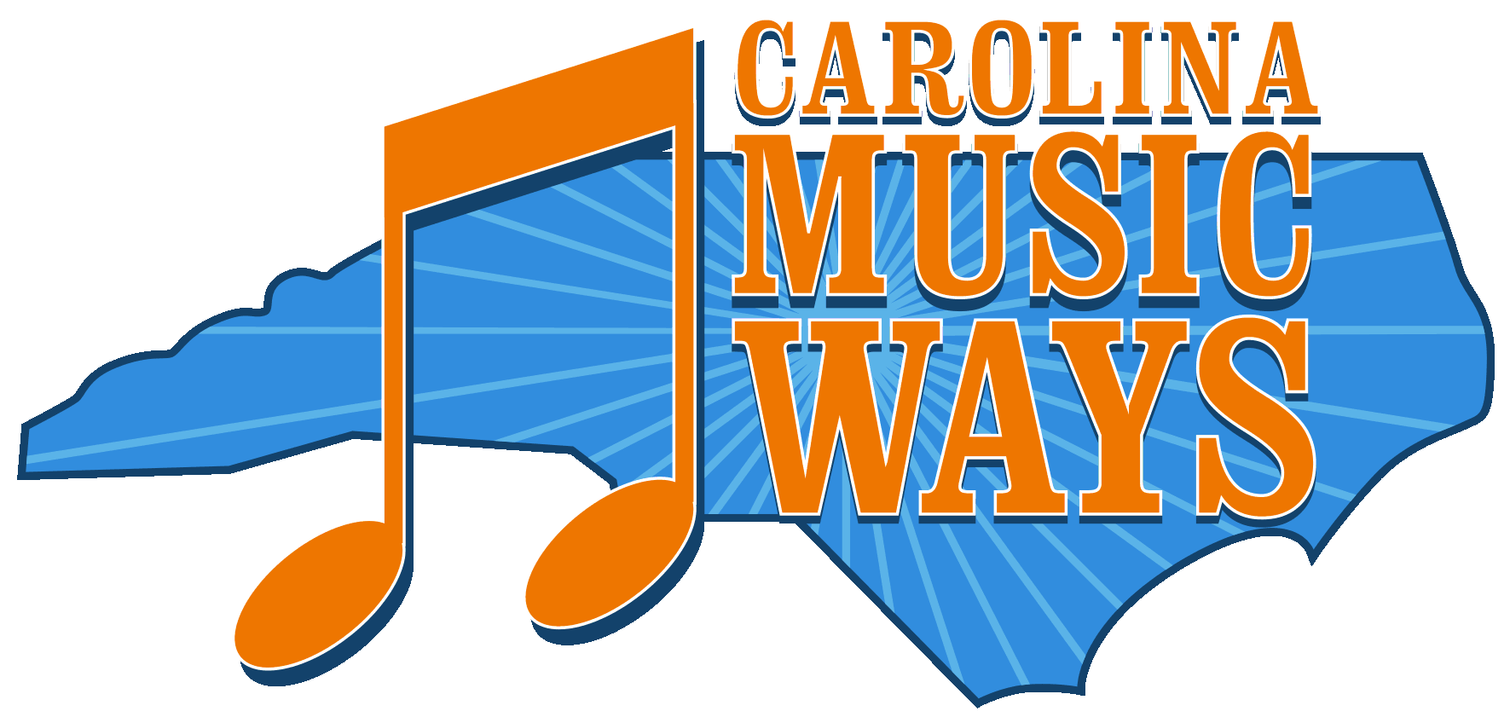
For more information, visit www.carolinamusicways.org.
MUSIC CLASS POWER POINT
for the school assembly show
Do not duplicate or download this PowerPoint or any images herein.
Carolina Music Ways © 2024
Credit requested when using this power point

Slide 5
In the late 1700s in Salem, Moravians performed brass band music for special events, like George Washington’s visit. (painting by Werner Willis, www.wernerwillisfineart.com) (Song 1)

Slide 6
Famous North Carolina Band: The Salem Band
(1771-Today) (Song 1)

Slide 7
Music Style: Moravian brass
Instruments Typically Used:
brass instruments, such as
trombones, trumpets, tubas
Song: “Mit Freuden Zart”
Performed by: Gianinni Brass
(Song 1: https://www.youtube.com/watch?v=EbP1cTcc8uY)

Slide 8
Old-time music has its roots in colonial days. Beginning in the 1700s, many North Carolinians loved to dance to it.
(Song 2)

Slide 9
Famous
North Carolina Musician: Tommy Jarrell
(1901–1985)
(Song 2)

Slide 10
Music Style: Old Time Stringband
Instruments Typically Used:
fiddle, banjo, guitar
Song: “Sail Away Ladies”
Performed by: Strictly Strings band
( Song 2: https://www.youtube.com/watch?v=UvtK3esGdGA)

Slide 11
The blues became popular in North Carolina
beginning in the 1920s. Often, bluesmen performed
in front of tobacco warehouses in cities like Durham and Winston- Salem.
(Song 3)

Slide 12
Famous North Carolina
Musician: Blind Boy Fuller (1907–1941)
(Song 3)

Slide 13
Music Style: Piedmont Blues
Instruments Typically Used:
guitar, harmonica
Song: “Walking My Troubles Away”
Performed by: Blind Boy Fuller
(Song 3: https://www.youtube.com/watch?v=Ht3M6scDDzs)

Slide 14
Beginning in the 1920s, jazz became popular in this state. Above, “Harding’s Camel City Orchestra” performs at Pythian Hall in downtown Winston-Salem.
(Song 4)

Slide 15
Famous North Carolina Musician: John Coltrane (1926–1967)
(Song 4)

Slide 16
Music Style: Jazz
Instruments Typically Used:
sax, drums, trumpet, bass, piano
Song: “Impressions”
Performed by: John Coltrane
(Song 4: https://www.youtube.com/watch?v=03juO5oS2gg)

Slide 17
Beginning in the 1920s, gospel became popular here and was sung in churches.
(Song 5)

Slide 18
Famous
North Carolina
Musician:
Shirley
Caesar
(1938 - )
(Song 5)

Slide 19
Music Style: Gospel
Instruments Typically Used:
vocals, piano, organ Song: “This Litle Light of Mine”
Performed by: 100 Voices of Gospel
(Song 5: https://www.youtube.com/watch?v=8kRCFr85O6M)

Slide 20
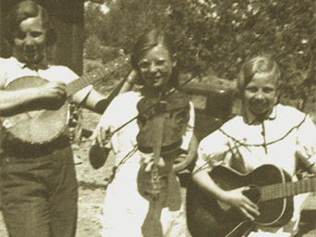
In the 1940s, bluegrass became popular here and bluegrass festivals held contests for adults and children. (Song 6)

Slide 21
Famous
North Carolina
Musician:
Doc Watson
(1923–2012)
(Song 6)

Slide 22
Music Style: Bluegrass
Instruments Typically Used:
guitar, banjo, fiddle,
mandolin, upright bass
Song: “The Crawdad Song”
Performed by: Doc Watson and
Clarence Ashley
(Song 6:https://www.youtube.com/watch?v=fDajv6RowvI)

Slide 23
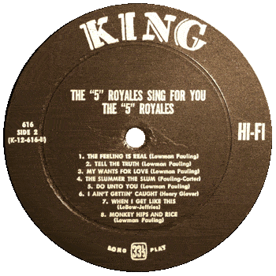
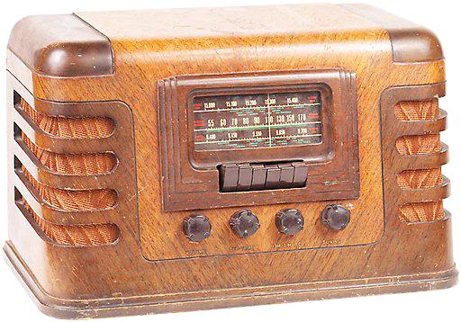
R&B
became popular here in the 1950s on
records, radio, jukeboxes
and at
music clubs.
(Song 7)

Slide 24
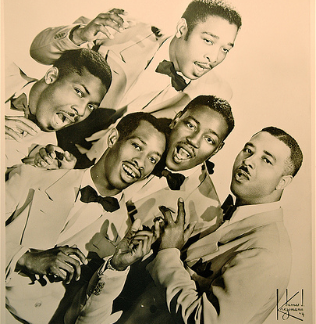
Famous North Carolina
Group: “5” Royales
(performed
1952 –1965)
(Song 7)

Slide 25
Music Style: Rhythm and Blues
Instruments Typically Used: vocals, drums, bass, guitar, piano, trumpets, sax
Song: “Dedicated to the One I Love”
Performed by: “5” Royales
(Song 7: https://www.youtube.com/watch?v=y335E8mfBAU)

Slide 26
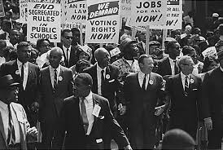
1963 March on Washington
During the 1960s, some R&B songs expressed yearning for equality and freedom, and people sang these songs at Civil Rights marches.

Slide 27
Famous NC Musician:
Nina Simone
(1933 – 2003)
(Alternative song 7)

Slide 28
Music Style: R&B Civil Rights Music
Instruments Typically Used: vocals, piano, bass, guitar, drums, trumpets, sax
Song: “I Wish I Knew How It
Would Feel To Be Free”
Performed by: Nina Simone
(Alternative song 7: https://www.youtube.com/watch?v=inNBpizpZkE

Slide 29
Similarities and Differences
Moravian Brass:
Examples of similarities: brass instruments also commonly used in jazz
Examples of differences: unlike jazz, this has major scale, no syncopation
Jazz:
Examples of similarities: has blues influences, blues scale often used; instrumental solos common, like in bluegrass
Examples of differences: more syncopation than Moravian
Old-Time Stringband:
Examples of similarities: it has African-American influences (banjo came from Africa), it has major and minor keys (no blues key)
Examples of differences: unlike jazz and Moravian, no brass or woodwind instruments
Bluegrass:
Examples of similarities: came from old-time stringband music, but faster; instrumental solos, like jazz; close harmonies, like R&B
Examples of differences: no brass or woodwinds families; major, minor, and blues keys

Slide 30
Similarities and Differences
Piedmont Blues:
Examples of similarities: features stringed instruments, as does old-time stringband and bluegrass
Examples of differences: no woodwinds or brass families; blues scale; more syncopation than Moravian
Gospel:
Examples of similarities: contains jazz and blues influences; blues scale often used
Examples of differences: more syncopation than Moravian
Rhythm and Blues:
Examples of similarities: has blues, African American gospel, and jazz influences; has close harmonies, like bluegrass
Examples of differences: unlike Moravian, has syncopation; unlike gospel has non-religious words

Slide 31
AUDIENCE ETIQUETTE (Optional Slide)
This show is an experience between the performers and you, the audience.
Please follow these guidelines:
Sit straight with arms and legs to yourself.
Look ahead at the performers.
Be a good listener. Please, no talking to your classmates during the show.
At the end of each song, thank the performers by clapping.
When a performer asks the audience a question and you want to answer it, please raise your hand.
Be polite to your fellow students who perform onstage.
When a performer asks you to sing along or clap to the music, please do!

Slide 32
Image Credits
Salem Band
www.northcarolinahistory.org
Old Time Barn Dance
http://www.bigroast.com/wp-content/uploads/2010/07/hog-roast-balham-will-help-with-your-barn-dance.jpg
Tommy Jarrell
www.arts.endow.gov
Tobacco Warehouses downtown Winston-Salem
www.cityofws.org/.../CityOfWinston-SalemHistory

Slide 33
Image Credits (continued)
Blind Boy Fuller
http://themusicsover.wordpress.com
Old Time Barn Dance
greenerloudoun.wordpress.com/category/events
Tommy Jarrell, 1st photo
www.arts.endow.gov
Pythian Hall, Harding’s Camel City Orchestra
Winston-Salem: A History by Frank Tursi, pp.242-243
John Coltrane, 1st image
www.kalamu.com/.../

Slide 34
Image Credits (continued)
African American choir
www.gbmnews.com/.../Page1.html
Shirley Caesar
mog.com/music/Shirley_Caesar
Doc Watson, 1st photo
www.davidholt.com/photos/doc_watson.html
5 Royales record (left)
thehoundblog.blogspot.com/2009_05_01_archive.html
5 Royales
www.gocontinental.com/cat/_f.htm
Nina Simone
1963 March: commons.wikipedia.org
http://www.gpbnews.org/post/black-music-voices-cultural-and-social-change

Slide 35
CREDIT REQUEST
Give Us Credit!
If you are a student, teacher, scholar, or other wishing to use this PDF power point
for noncommercial purposes, please credit us by acknowledging the following:
Organization: Carolina Music Ways
Title: Music Class Power Point for Carolina Live!—Our Musical History
Web Address: As shown
Please Note: Do not duplicate or download this PowerPoint or any images herein.
Music Class

Slide 36
This PowerPoint accompanies the Music Class unit that goes with the school show Carolina Live!—Our Musical History. It was created by Elizabeth A. Carlson, Ed.M., Program Director for Carolina Music Ways. Carlson is an educator and author who focuses on North Carolina’s rich musical history.
Carolina Music Ways offers its standards-aligned curriculum to educators for free. Interdisciplinary lessons in music, language arts, and social studies increase students’ understanding of North Carolina’s history and musical treasures.

